Slide 1
Goucher College
Graduate and Professional Studies Marketing
November 9, 2023

Slide 2
Intros
David Franek President & Chief Creative Officer
Jeff Goelz Business Development
Cory Farrugia Senior Account Director
Rachel Deutsch Creative Director
Dan Coury Account Supervisor & Digital Strategist
Alan Moore Digital Marketing Strategist - LocaliQ

Slide 3
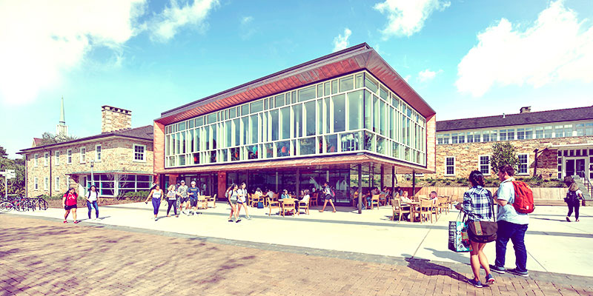
Agenda
Objectives & goals
Our approach
Discuss regional branding
How TDC’s offering is different and tailored to Goucher
Digital and non-digital strategy
How we plan to spend the budget
Evaluating current creative
Timing
Reporting
Why TDC

Slide 4
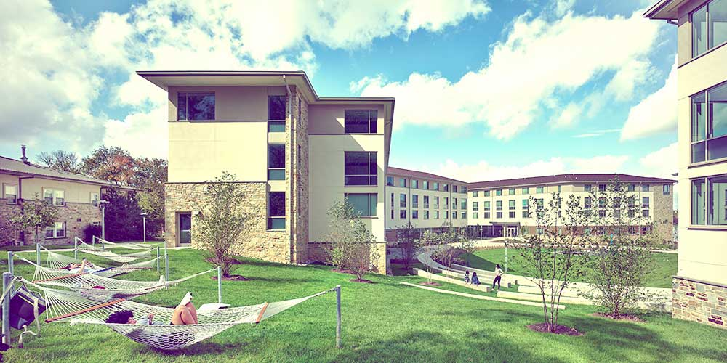
Objectives
Strengthen overall regional awareness of Goucher’s graduate programs.
Focus especially on launching three M.A. programs anticipated to perform well in attracting interest/enrollment (Applied Policy Analysis, Digital Communications, and Environmental Sustainability and Management).
Promote three (3) Master’s programs in Education and four (4) niche/low-residency Master’s programs.

Slide 5
Goucher Master’s Programs
Special focus on launching three innovative programs:
Master of Arts in Applied Policy Analysis
Master of Arts in Digital Communications
Master of Arts in Environmental Sustainability and Management
Other high-priority programs:
Master of Arts in Teaching
Master of Education
Master of Science in Higher Education Policy, Research & Administration
Niche, low residency graduate programs:
Master of Arts in Arts Administration
Master of Arts in Cultural Sustainability
Master of Arts in Historic Preservation
Master of Fine Arts in Nonfiction

Slide 6
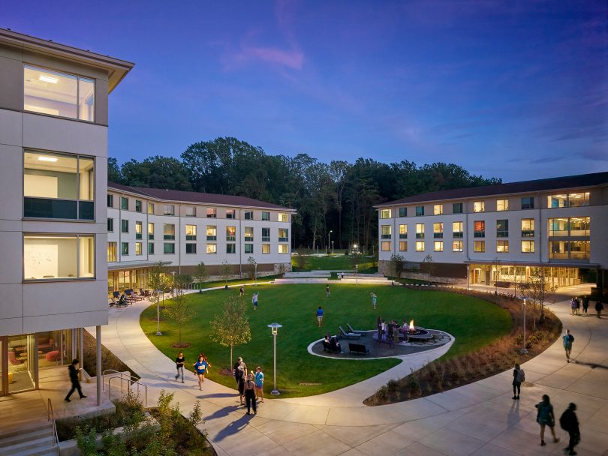
Project Goals
Develop a consistent stream of qualified domestic/regional leads for graduate programs.
Help convert qualified leads into enrolled students.
Strengthen Goucher’s brand awareness for its graduate/professional studies programs through regional digital marketing and relevant tactics.

Slide 7
Our Approach
Recapping TDC’s Plan in the RFP Response – digital media and branding
2023/24 (8 months) $177,500 | 2024/25 (12 months) $300,000
Projected Agency Services Projected Agency Services $40,250 Estimated Outside Hard Costs Display advertising + retargeting (4 cycles, $1,500 per) $6,000 Search engine marketing (4 cycles, $17,000 per) $68,000 YouTube TrueView $22,530 CTV (video ads) $12,706 Cable/OTT $14,114 One day of on-campus videography + editing $8,500 Voiceover recording, music, mixing $2,500 Stock photography $1,100 Miscellaneous expenses $1,800 Projected Outside Services $137,250 | Projected Agency Services Projected Agency Services $58,700 Estimated Outside Hard Costs Display advertising + retargeting (6 cycles, $1,500 per) $9,000 Search engine marketing (6 cycles, $17,000 per) $102,000 Geofencing 25 target campuses (6 cycles, $2,000 per) $12,000 Social media advertising (4 cycles, $4,000 per) $16,000 YouTube TrueView $23,530 CTV (video ads) $19,048 Cable/OTT $56,472 Stock photography $1,100 Miscellaneous expenses $2,150 Projected Outside Services $241,300
Digital Forecasting | Branding Forecasting
249,124 – 492,288 impressions 3,251 – 5,722 clicks | 5,780,400 impressions
Digital Forecasting | Branding Forecasting
3,126,750 – 5,165,611 impressions 12,565 – 18,616 clicks | 6,023,600 impressions

Slide 8
Our Approach
Another Option for Consideration – going fully digital
2023/24 (8 months) $177,500 | 2024/25 (12 months) $300,000
Projected Agency Services Projected Agency Services $40,250 Estimated Outside Hard Costs SEM, display, retargeting (7 cycles, $14,760 per) $103,320 YouTube TrueView $22,530 One day of on-campus videography + editing $8,500 Miscellaneous & stock photography $2,900 Projected Outside Services $137,250 | Projected Agency Services Projected Agency Services $58,700 Estimated Outside Hard Costs SEM, display, retargeting (12 cycles, $15,540 per) $186,520 Geofencing 25 target campuses (6 cycles, $2,000 per) $12,000 Social media advertising (4 cycles, $4,000 per) $16,000 YouTube TrueView $23,530 Miscellaneous & stock photography $3,250 Projected Outside Services $241,300
SEM and Display Forecasting | TrueView Forecasting
379,071 – 797,020 impressions 5,306 – 10,885 clicks | 4,310,400 impressions
SEM, Display, Geofencing, Social Media Forecasting | TrueView Forecasting
3,402,900 – 5,793,499 impressions 16,784 – 28,694 clicks | 2,873,600 impressions

Slide 9
Our Approach
Recapping the Forecasting
2023/24 $177,500 |  | 2024/25 $300,000
Digital + Branding Totals (8 months) | 6,029,524 – 6,272,688 impressions 3,251 – 5,722 clicks | Digital + Branding Totals (12 months) | 9,150,350 – 11,189,211 impressions 12,565 – 18,616 clicks
Digital Only Totals (8 months) | 4,689,471 – 5,107,420 impressions 5,306 – 10,885 clicks | Digital Only Totals (12 months) | 6,276,500 – 8,667,099 impressions 16,784 – 28,694 clicks
High-level takeaways:
Digital paired with branding will generate considerably more impressions, which helps generate a greater boost of overall brand awareness in the market.
Condensing your campaign will generate a stronger impact because we’re able to be more competitive (via bidding strategies) in the market against those with similar campaign tactics.
Clicks increase dramatically with an all digital-focused campaign due to the main goal of driving web traffic.

Slide 10
Our Approach – 2023/24
Forecasting Engagement – Three Innovative Programs
SEM: Master of Arts in Applied Policy Analysis
200 – 1,907 impressions
25 – 75 clicks
4.8% click-through rate
$600 estimated monthly spend
SEM: Master of Arts in Digital Communications
200 – 1,700 impressions
25 – 75 clicks
5.3% click-through rate
$100 estimated monthly spend
SEM: Master of Arts in Environmental Sustainability and Management
625 – 3,265 impressions
25 – 99 clicks
2.9% click-through rate
$2,500 estimated monthly spend

Slide 11
Our Approach – 2023/24
Forecasting Engagement – High Priority Programs
SEM: Master of Arts in Teaching
1,339 – 5,339 impressions
69 – 169 clicks
3.6% click-through rate
$2,700 estimated monthly spend
SEM: Master of Education
10,992 – 15,992 impressions
492 – 842 clicks
4.9% click-through rate
$6,900 estimated monthly spend
SEM: Master of Science in Higher Education Policy, Research & Administration
597 – 3,597 impressions
50 – 125 clicks
4.2% click-through rate
$1,450 estimated monthly spend

Slide 12
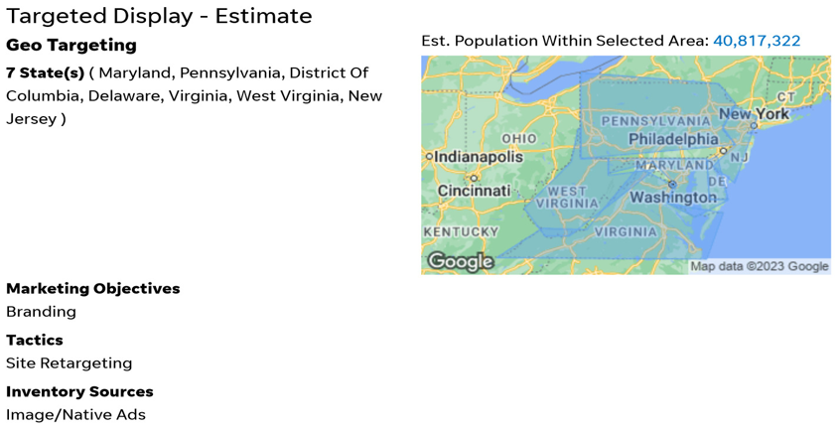
Our Approach – 2023/24
Forecasting Engagement – Niche Programs & Targeted Display
SEM: Niche Programs
200 – 1,700 impressions
25 – 75 clicks
5.3% click-through rate
$150 estimated monthly spend
Targeted Display, Site Retargeting
440 – 890 daily reach
40,000 – 80,000 impressions
47 – 95 clicks
9 – 19 view-through website visits
$400 estimated monthly spend

Slide 13
Our Approach – 2023/24
Forecasting Engagement – Geofencing & Social Media Advertising
Geofencing
13,300 – 26,700 daily reach
1,200,000 – 2,400,000 impressions
1,439 – 2,879 clicks
287 – 575 view-through website visits
Social Media Advertising
26,000 – 68,000 daily reach
1,553,064 – 2,027,179 impressions
6,244 – 7,155 clicks

Slide 14
Our Approach – 2024/25
Forecasting Engagement – Three Innovative Programs
SEM: Master of Arts in Applied Policy Analysis
200 – 1,907 impressions
25 – 75 clicks
4.8% click-through rate
$600 estimated monthly spend
SEM: Master of Arts in Digital Communications
200 – 1,700 impressions
25 – 75 clicks
5.3% click-through rate
$100 estimated monthly spend
SEM: Master of Arts in Environmental Sustainability and Management
667 – 3,667 impressions
26 – 101 clicks
2.9% click-through rate
$2,600 estimated monthly spend

Slide 15
Our Approach – 2024/25
Forecasting Engagement – High Priority Programs
SEM: Master of Arts in Teaching
1,450 – 5,450 impressions
72 – 172 clicks
3.5% click-through rate
$2,850 estimated monthly spend
SEM: Master of Education
11,368 – 16,368 impressions
507 – 857 clicks
4.9% click-through rate
$7,300 estimated monthly spend
SEM: Master of Science in Higher Education Policy, Research & Administration
683 – 3,683 impressions
53 – 153 clicks
4.7% click-through rate
$1,550 estimated monthly spend

Slide 16
Our Approach – 2024/25
Forecasting Engagement – Niche Programs & Targeted Display
SEM: Niche Programs
200 – 1,700 impressions
25 – 75 clicks
5.3% click-through rate
$150 estimated monthly spend
Targeted Display, Site Retargeting
440 – 890 daily reach
40,000 – 80,000 impressions
47 – 95 clicks
9 – 19 view-through website visits
$400 estimated monthly spend

Slide 17
Our Approach – 2024/25
Forecasting Engagement – Geofencing & Social Media Advertising
Geofencing
13,300 – 26,700 daily reach
1,200,000 – 2,400,000 impressions
1,439 – 2,879 clicks
287 – 575 view-through website visits
Social Media Advertising
26,000 – 68,000 daily reach
1,553,064 – 2,027,179 impressions
6,244 – 7,155 clicks

Slide 18
Discussing Regional Branding Campaign
We also would like your opinion/take on an overall “Grad at Goucher”
regional brand campaign.
Recommend digital and branding component. Raises demand better than a strictly digital campaign.
Maintains a sustained approach in generating applications for student enrollment.
In our RFP submission, TDC recommended a hybrid program with 70% digital spend and 30% brand spend working together. A mix of brand and digital supports lift.
Do we wish the budget was more? Yes, let’s discuss.

Slide 19
How TDC’s Offering is Different and Tailored to Goucher
TDC is more than a digital marketing solution. We offer a full complement of strategic marketing tactics with deep experience in higher education.
We strongly believe in the power of a captivating creative approach and strong messaging to make a difference. From experience we know being BOLD is GOOD when marketing in higher education.
Yet we also understand that testing and refinement is necessary, and we have no reservations about changing a creative direction that isn’t yielding the results needed.
TDC doesn’t do cookie-cutter solutions. TDC’s plans are specifically designed around every client’s unique needs. Our work for Goucher will be grounded in our knowledge of effective strategies but will be entirely tailored to meeting your challenges.
We are client-centric through our account services.
How is what you are offering going to be different, innovative, and tailored to Goucher?

Slide 20
Digital and Non-Digital Strategy
What is your regional integrated digital and (possibly) non-digital strategy?
Digital marketing is the primary media we would use to achieve Goucher’s objectives. However, we recommend an integrated approach using brand awareness advertising as well.
We proposed a regional media targeted approach, but we could narrow the focus to just the Baltimore DMA.
In our RFP response we recommended the following media:
2023/24 | 2024/25 includes same tactics as 2023/24 plus the following:
Search Engine Marketing (SEM) | Geofencing
Display advertising w/ retargeting | Social media advertising
YouTube TrueView
CTV (video ads)
Cable/OTT

Slide 21
How We Plan to Spend the Budget
Please tell us how you plan to spend the budget. Digital and branding.
2023/24 $177,500 | 2024/25 $300,000
Projected Agency Services Planning, kickoff, and creative brief $3,000 Adjust or refine existing creative for A/B testing $5,250 Create one set of animated banner ads (4 sizes) $3,500 Concept and create one, :30 spot + :15 companion $9,750 Account mgmt. + monthly reporting ($2,500 x 7.5 mo.) $18,750 Projected Agency Services $40,250 Estimated Outside Hard Costs Display advertising + retargeting (4 cycles, $1,500 per) $6,000 Search engine marketing (4 cycles, $17,000 per) $68,000 YouTube TrueView $22,530 CTV (video ads) $12,706 Cable/OTT $14,114 One day of on-campus videography + editing $8,500 Voiceover recording, music, mixing $2,500 Stock photography $1,100 Miscellaneous expenses $1,800 Projected Outside Services $137,250 | Projected Agency Services Planning and creative brief $2,000 Creative concepting for new series of A/B test ads $5,250 Create two sets of animated banner ads (8 total ads) $5,450 Create social media video ads (3 ad sizes) $5,000 Create social media graphics (10-12 total) $5,000 Account mgmt. + monthly reporting ($3,000 x 12 mo.) $36,000 Projected Agency Services $58,700 Estimated Outside Hard Costs Display advertising + retargeting (6 cycles, $1,500 per) $9,000 Search engine marketing (6 cycles, $17,000 per) $102,000 Geofencing 25 target campuses (6 cycles, $2,000 per) $12,000 Social media advertising (4 cycles, $4,000 per) $16,000 YouTube TrueView $23,530 CTV (video ads) $19,048 Cable/OTT $56,472 Stock photography $1,100 Miscellaneous expenses $2,150 Projected Outside Services $241,300

Slide 22
How We Plan to Spend the Budget
Please tell us how you plan to spend the budget. Fully digital.
2023/24 $177,500 | 2024/25 $300,000
Projected Agency Services Planning, kickoff, and creative brief $3,000 Adjust or refine existing creative for A/B testing $5,250 Create one set of animated banner ads (4 sizes) $3,500 Concept and create one, :30 spot + :15 companion $9,750 Account mgmt. + monthly reporting ($2,500 x 7.5 mo.) $18,750 Projected Agency Services $40,250 Estimated Outside Hard Costs Display advertising + retargeting (7 cycles, $400 per) $2,800 Search engine marketing (7 cycles, $14,360 per) $100,520 YouTube TrueView $22,530 One day of on-campus videography + editing $8,500 Stock photography $1,100 Miscellaneous expenses $1,800 Projected Outside Services $137,250 | Projected Agency Services Planning and creative brief $2,000 Creative concepting for new series of A/B test ads $5,250 Create two sets of animated banner ads (8 total ads) $5,450 Create social media video ads (3 ad sizes) $5,000 Create social media graphics (10-12 total) $5,000 Account mgmt + monthly reporting ($3,000 x 12 mo.) $36,000 Projected Agency Services $58,700 Estimated Outside Hard Costs Display advertising + retargeting (12 cycles, $400 per) $4,800 Search engine marketing (12 cycles, $15,143 per) $181,720 Geofencing 25 target campuses (6 cycles, $2,000 per) $12,000 Social media advertising (4 cycles, $4,000 per) $16,000 YouTube TrueView $23,530 Stock photography $1,100 Miscellaneous expenses $2,150 Projected Outside Services $241,300

Slide 23
Evaluating Current Creative
The creative: tell us what is good, what can be used, and what needs to be changed.

Slide 25
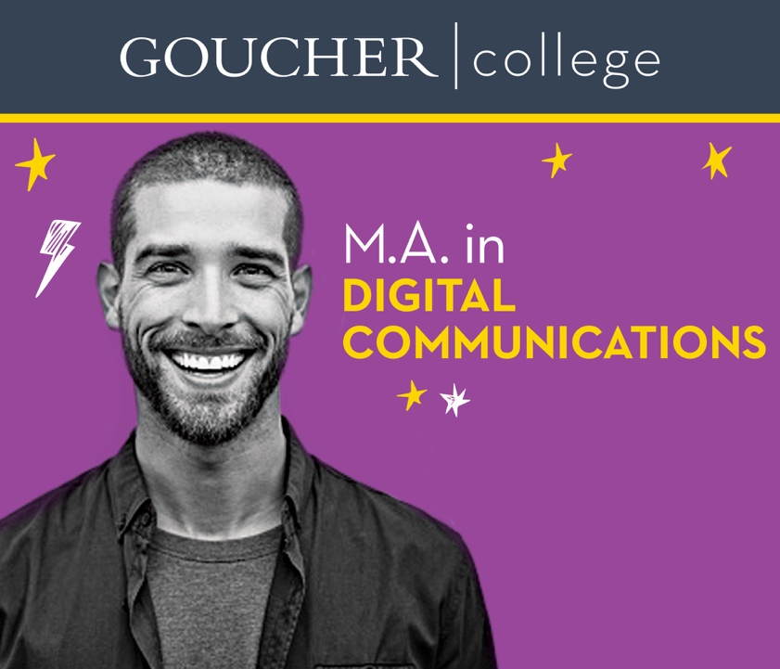

Slide 26
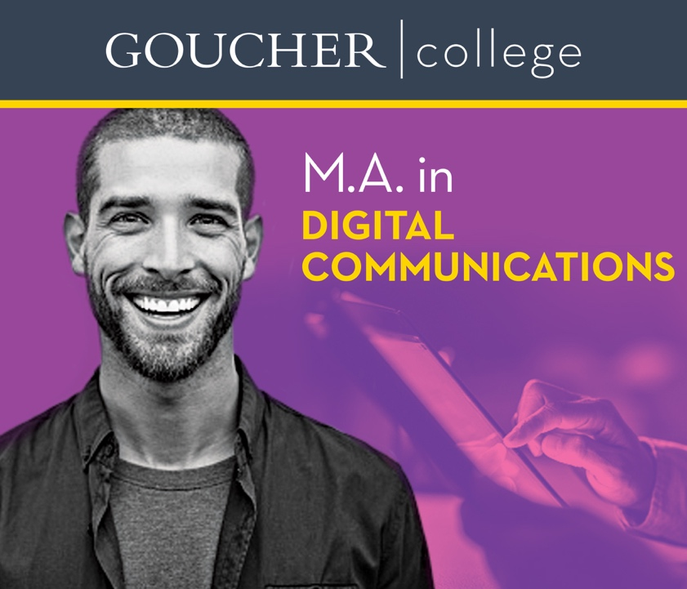

Slide 27
Timing
How will you accomplish getting the marketing out ASAP and getting to know us?
TDC anticipated this by already doing some creative tweaks shown today to jump start the process.
TDC will have a formal kick-off meeting with Goucher to familiarize ourselves with the college, current branding, and target audience. During that meeting our teams will review the media plans outlined in the RFP submission and determine any refinements.
From there TDC will distill all the information into a creative brief that summarizes the situation, challenges, audiences, and identifies the key elements of the campaign to develop any additional creative tactics.
We will set up a weekly status meeting for Goucher and TDC to review progress, keep everyone informed, and monitor the campaign and media tactics.

Slide 28
Timing
Goucher College 2023/24 Media Flowchart (8 months)

Slide 29
Timing
Goucher College 2024/25 Media Flowchart (12 months)

Slide 30
Reporting
How will Goucher receive reports? Discuss formatting, trends, takeaways, insights, recommendations, etc.
TDC will closely monitor performance to ensure we’re reaching target goals, impressions, clicks, and more.
Have a user-friendly demand side platform (DSP) dashboard that monitors all live digital media and provides key insights (budget pacing, trends, engagement).
TDC provides a comprehensive monthly report that details engagement on all digital and social media. Reports include a breakdown of all key performance indicators (KPIs), takeaways, and recommendations.
Our teams will review/discuss reporting and performance during a weekly status meeting to ensure all questions are answered and everyone fully understands how the campaigns are tracking.

Slide 32
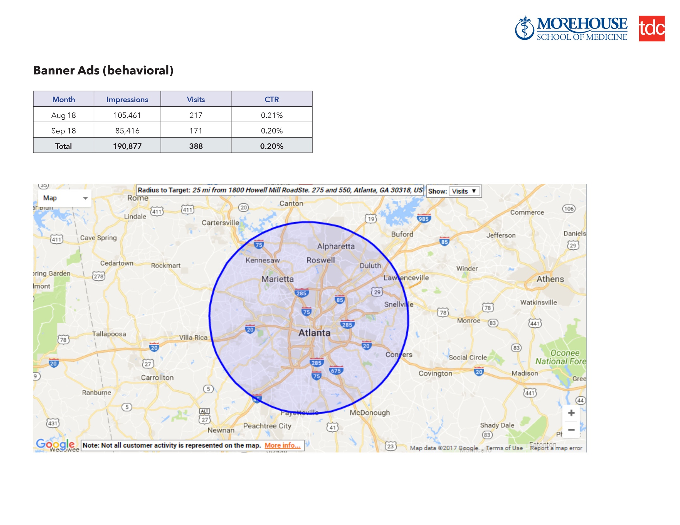
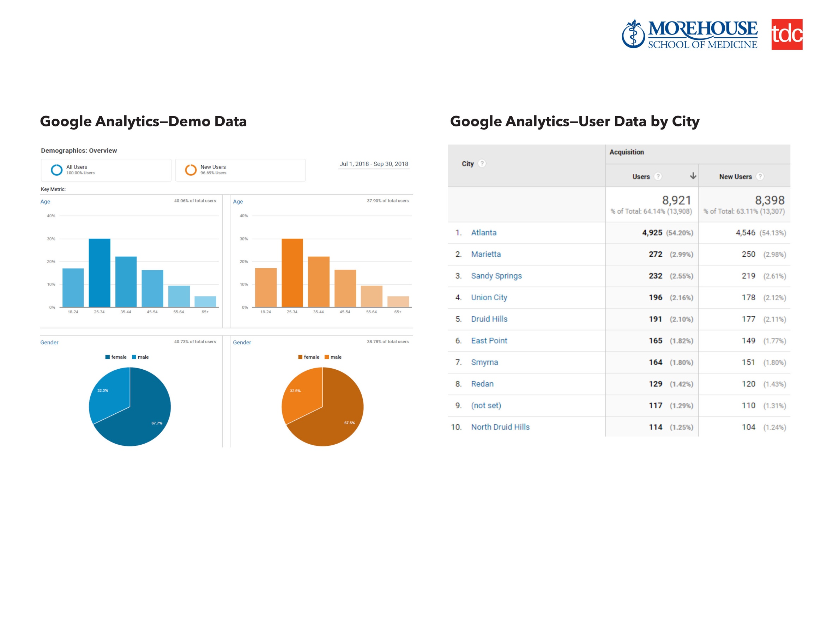

Slide 33
Why TDC
TDC is more than a digital solution
Educational institution branding & digital marketing expertise
Local & accessible
In-depth market knowledge
Passionate about enabling student success stories
Award-winning creative and client services

Slide 34
Thank you!
Washington Atlanta Baltimore

